Slide 1
web app
object:create web app using react,react router,bootstrap and google font.
description: in the web application I have used multiple pages components like login,resister,add sales,revenue,top prosuct,logout and Navbar components. I am showing all the components with its screenshot.

Slide 2
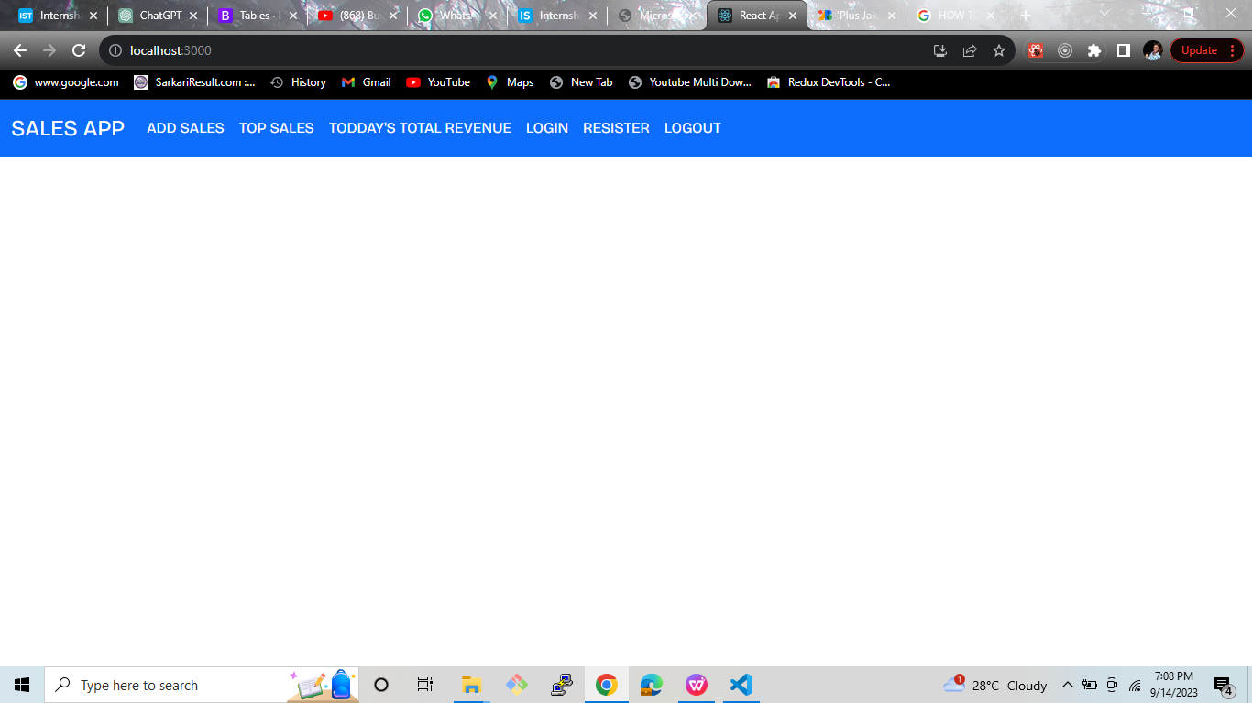
Navbar(Desktop Screen):

Slide 3
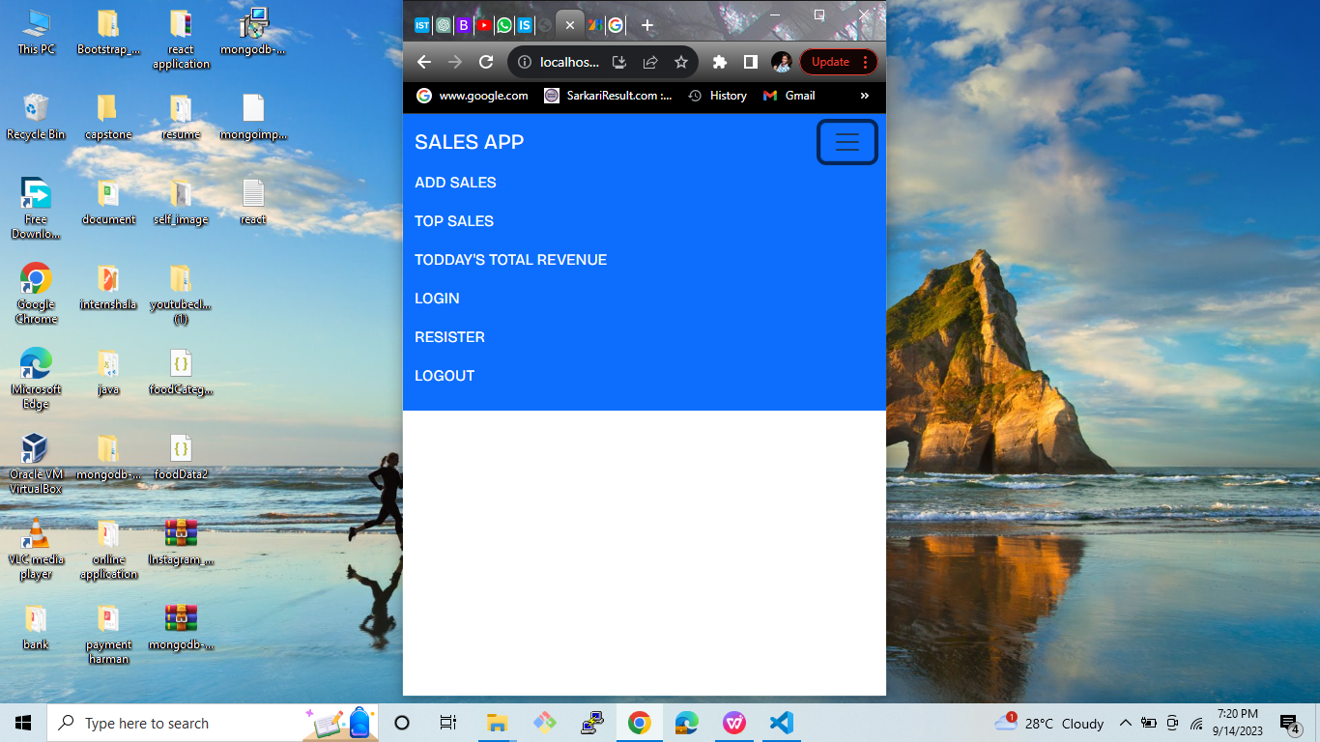
Navbar(Mobile Screen):

Slide 4
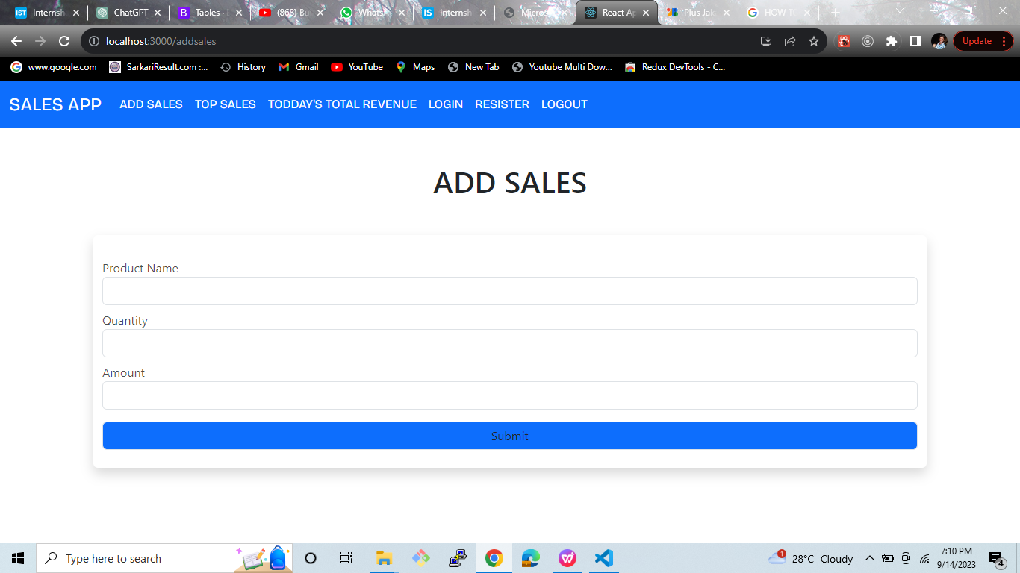
Add Sales (desktop):

Slide 5
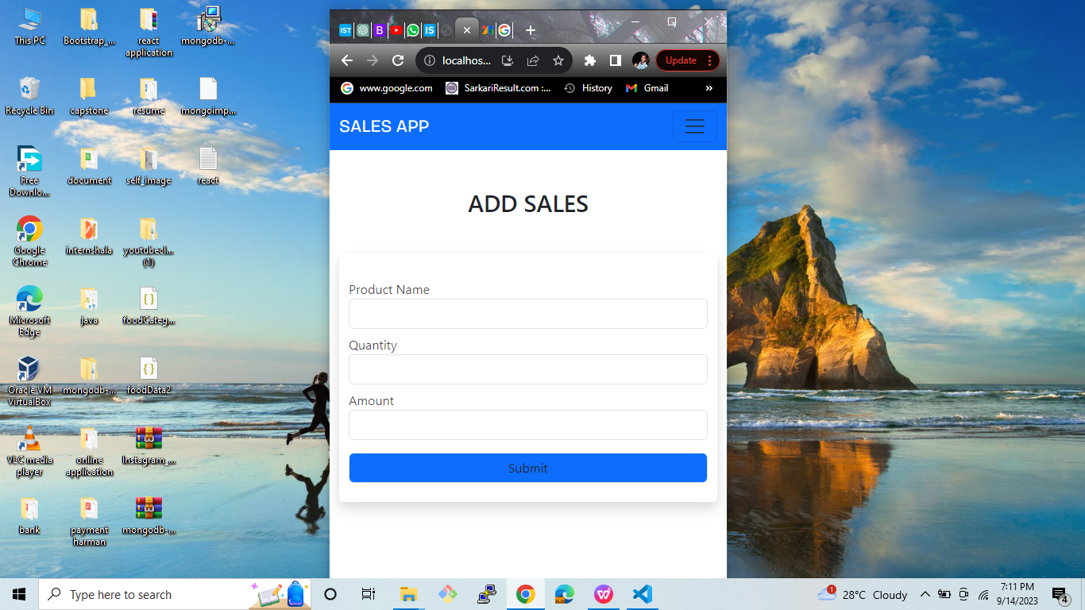
add sales (mobile screen):

Slide 6
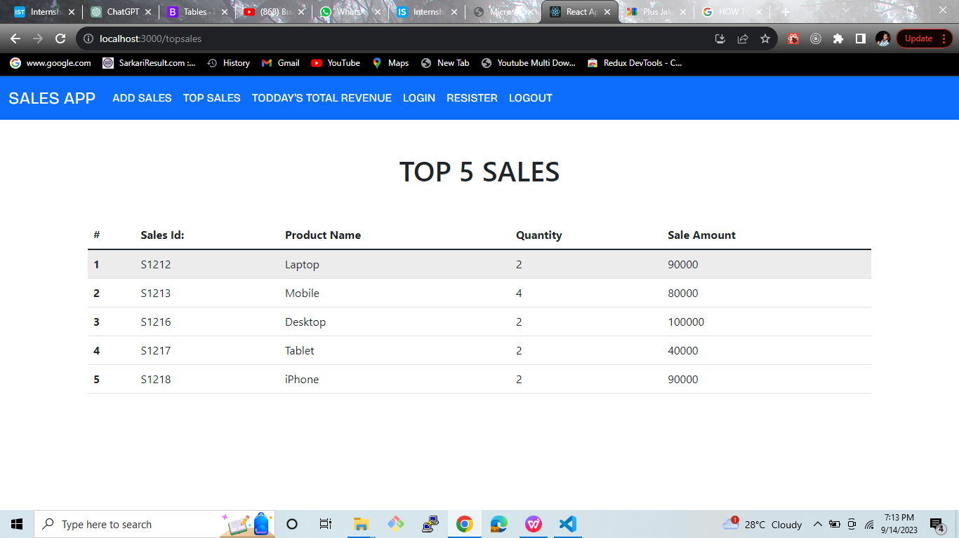
Top 5 Sales(desktop screen):

Slide 7
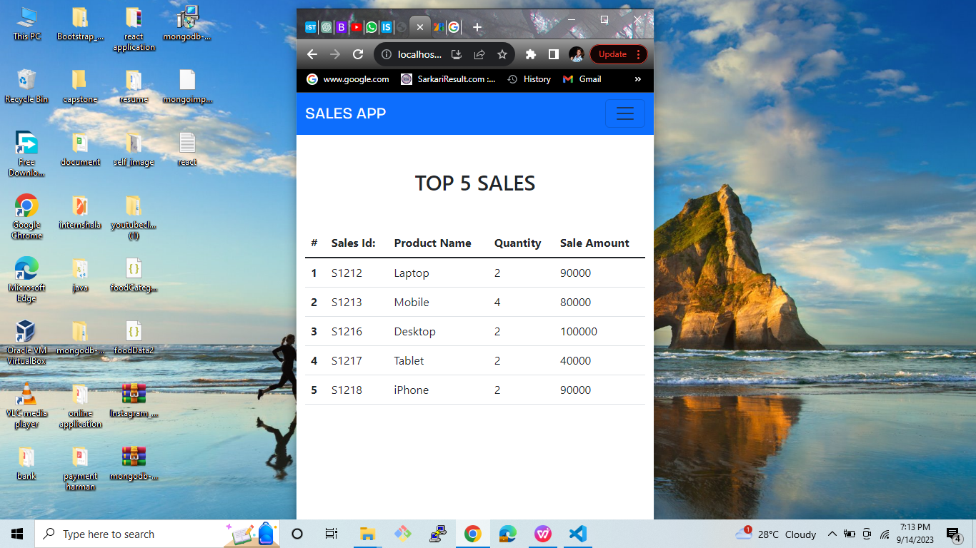
Top 5 sales(mobile screen):

Slide 8
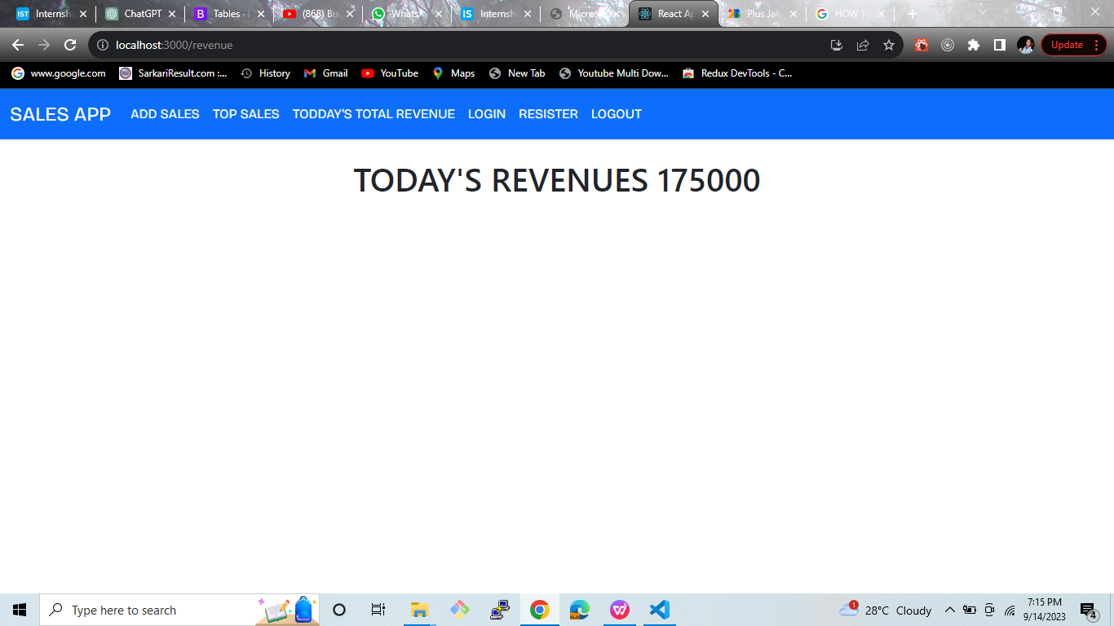
Today’s Revenue:

Slide 9
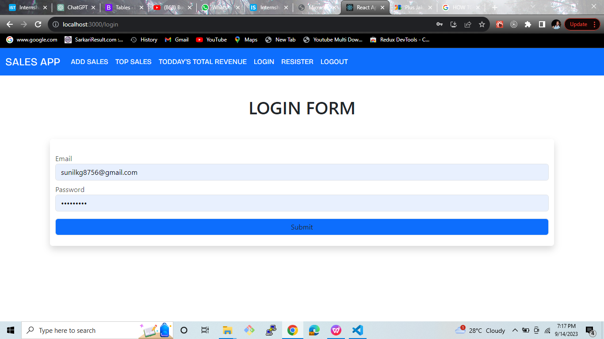
Login(Desktop Screen):

Slide 10
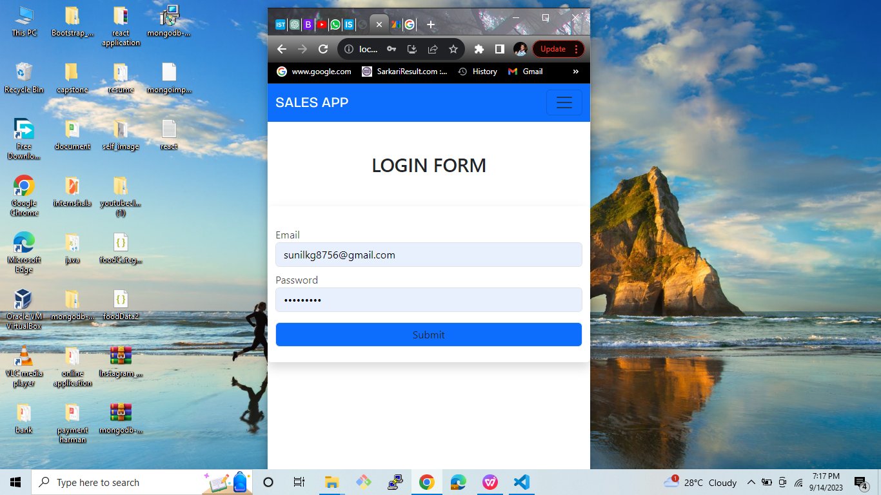
Login(Mobile Screen):

Slide 11
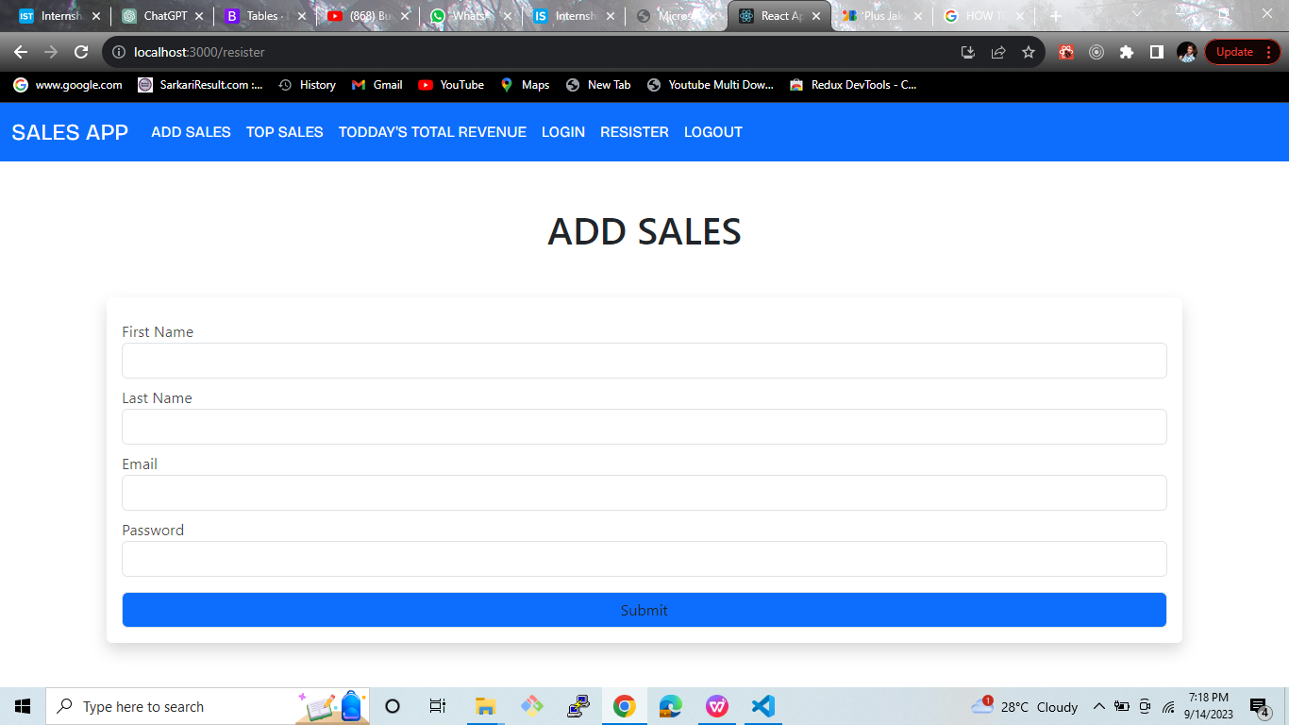
Resister(Desktop Screen):

Slide 12
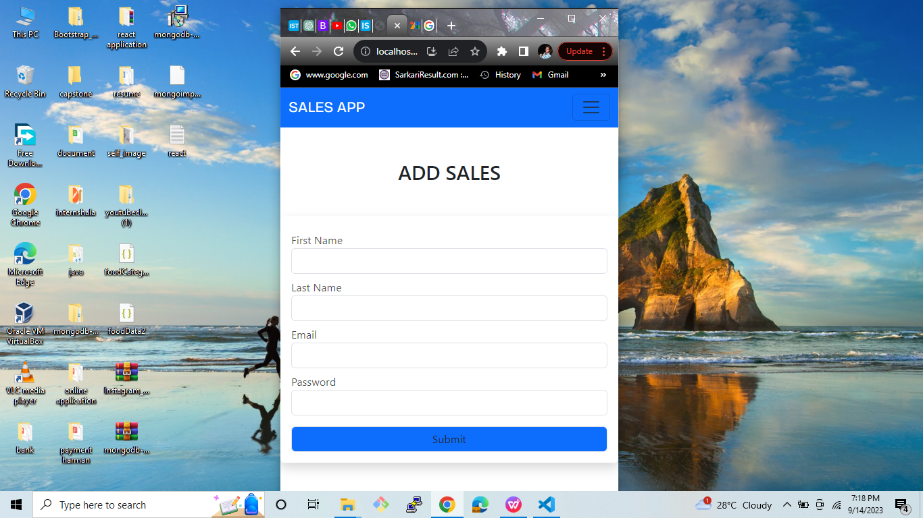
Resister (Mobile Screen):

